Slide 1


Top 5 Content Categories Analysis for Social Buzz

Slide 2


Today's agenda
Project recap
Problem
The Analytics team
Process
Insights
Summary

Slide 3

We analyzed Social Buzz’s content data to identify the top 5 categories with the highest popularity.
The analysis involved cleaning and merging datasets, calculating total scores, and delivering insights into content performance.
The findings will help Social Buzz enhance their content strategy and support their upcoming IPO preparations.
Project Recap

Slide 4

The project aimed to address the challenge of identifying which content categories on Social Buzz are the most popular among users.
With over 100,000 pieces of content posted daily and massive volumes of unstructured data, Social Buzz needed a clear understanding of content performance.
The problem was to accurately analyze and rank content categories based on user engagement to support strategic decision-making and optimize content strategies.
Problem

Slide 5



Managing Director
Mae Mulligan
(Client Lead)
The Analytics team
Lead IPO Strategist
Florian Henry
Data Scientist
Michelle Grove

Slide 6
REQUIREMENT GATHERING
Process
1
2
DATA CLEANING
3
DATA MERGING
4
DATA ANALYSIS
5
REPORTING AND PRESENTATION

Slide 7

Insights
Top Performing Categories: Identified which content categories have the highest engagement on Social Buzz.
User Preferences: Revealed the types of content that resonate most with users.
Trends Over Time: Analyzed how category popularity evolves, highlighting emerging trends.
Content Strategy: Provided recommendations for focusing on high-performing categories to boost engagement.
Business Alignment: Assessed how insights support Social Buzz’s business goals, including their IPO preparations.
Optimization Opportunities: Suggested ways to enhance content strategy based on user behavior and category performance.

Slide 8
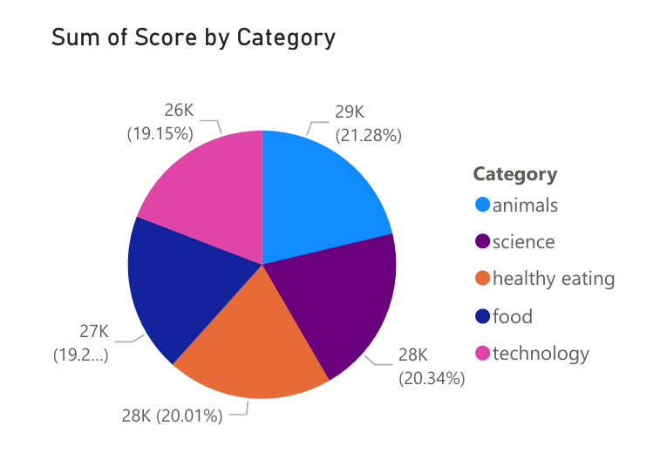
The pie chart displays the sum of scores for the top 5 content categories. The 'Animals' category has the highest score among these top categories.
This suggests that content related to animals generates the most reactions or scores compared to other categories

Slide 9
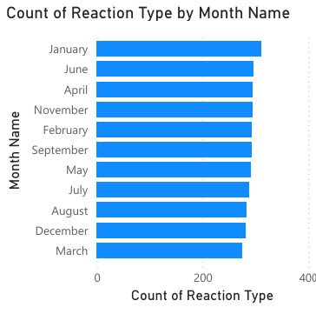
The bar chart above shows the count of reactions by month. Notably, January exhibits a significantly higher number of reactions compared to other months.

Slide 10
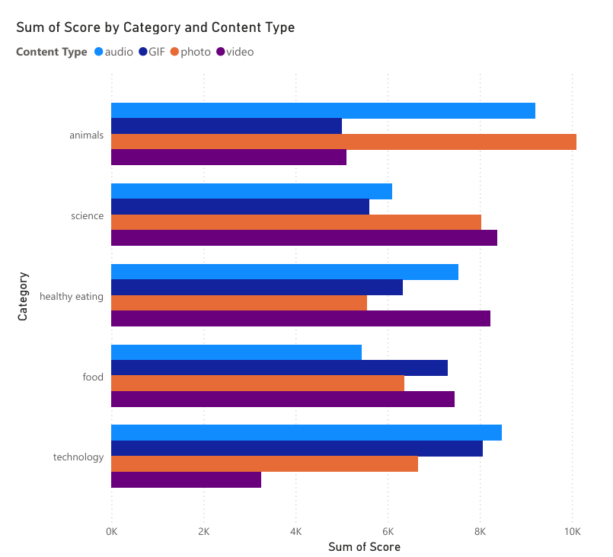
This bar chart illustrates the total scores for different content types across categories. It highlights that 'Photos' from the 'Animals' category have the highest score, while 'Videos' from the 'Technology' category have the lowest.

Slide 11

In conclusion, the analysis identified the top 5 content categories with the highest engagement on Social Buzz, revealing user preferences for certain types of content. It tracked trends over time to highlight shifts in popularity. Recommendations include optimizing content strategy by focusing on these high-performing categories. These insights align with Social Buzz’s business goals and IPO preparations, offering actionable guidance to enhance user engagement and support strategic growth.
Summary

Slide 12
Thank you!
ANY QUESTIONS?

